Slide 1
INTRODUCTION TO GENDER HIV AND AIDS
MAINSTREAMING IN AGRICULTURAL
PROGRAMMES AND PROJECTS

Slide 2
OBJECTIVES
By the end of the module participants will be able to:
State generic gender and HIV/ AIDS issues
Define terminologies related to gender, HIV and AIDS mainstreaming.
State the importance of gender, HIV and AIDS mainstreaming.
Explain the process of mainstreaming gender, HIV and AIDS in projects and programs.

Slide 3
PRESENTATION OUTLINE
Introduction to gender, HIV and AIDS mainstreaming.
Generic gender and HIV / AIDS issues.
Definition of terminologies.
Aim of gender, HIV and AIDS mainstreaming.
Importance of Gender, HIV and AIDS mainstreaming.
Process for Main streaming
Characteristics of GHA responsive program
Conclusion

Slide 4
INTRODUCTION
Ultimate outcome of Agricultural Programs and Projects is mostly Human (People) Development through:
- Increased food security
- Improved nutrition status
- Increased incomes
- Improved environmental sustainability
These people are in categories:
- Women and girls (70% of agriculture work)
- Men and boys (30% agricultural workforce)
- People Living with HIV ( 1million)
- Orphans and vulnerable children (1 million)
- Elderly and Persons with disabilities

Slide 5
INTRODUCTION…….
What is the existing situation?
Disparities exists in participation, access and control to resources and benefits between men and women, boys and girls.
There is minimal Integration of causes and effects of HIV and AIDS for the various gender categories in programs and projects.

Slide 6
INTRODUCTION…….
What Programs and Projects should do:
Reduce or close the gender disparities through mainstreaming of gender issues
Integrate the causes and effects of HIV and AIDS of the various gender categories

Slide 7
GENERIC GENDER ISSUES
Unequal power relations
- Women’s low level of participation in
decision making ie on production,
marketing & utilization of benefits
- Constrained in accessing productive
resources &
- Wealth creation opportunities
- Allocation of responsibilities favors men

Slide 8
GENERIC GENDER ISSUES…..
Women more overburdened with the
triple roles.
Limited access to agricultural inputs, resources, benefits and opportunities by women farmers

Slide 9
GENERIC GENDER ISSUES…..
    Women farmers’ limited control over agricultural inputs, resources, benefits and opportunities.
    Inadequate knowledge and skills by women farmers to implement recommended technologies

Slide 10
HIV AND AIDS ISSUES
Decreased labour productivity: Agriculture labour for women reduced
Erosion of household assets
Intergenerational knowledge loss
Weakened social cohesion and informal safety nets
Changes in the gender categories involved in Agricultural development. More single, elderly headed household and orphans
Weakened institutional capacity

Slide 11
DEFINITION OF TERMINOLOGIES

Slide 12
WHAT IS THE MAINSTREAM?
The regular and already existing development agenda

Slide 13
MAINSTREAMING
A process of identifying, internalizing, integrating and institutionalizing subject specific issues, concerns, needs and priorities so that they are part and parcel of a regular and already existing development agenda (project/programme).

Slide 14
WHAT MAINSTREAMING IS “NOT”
It is not business as usual – something must change.
It is not changing core functions and responsibilities of a project or programme.
It is not an add on function.

Slide 15
GENDER MAINSTREAMING
Integrating gender issues and concerns in the development agenda in order to address gender inequities.
UNDP defines it as addressing gender concerns at all levels and in all sectors of development which are crucial to the achievement of goals of democracy, poverty eradication, social justice and sustainable development.

Slide 16
HIV AND AIDS MAINSTREAMING
Defined by UNAIDS as a process that enables development actors to address the causes and effects HIV and AIDS in an effective manner both through their usual work (programs & projects) and through their workplace.

Slide 17
GENDER HIV AND AIDS
MAINSTREAMING
    A process of identifying, internalizing, integrating and institutionalizing Gender, HIV and AIDS issues, concerns, needs and priorities in the development, implementation, monitoring and evaluation of projects and programmes.

Slide 18
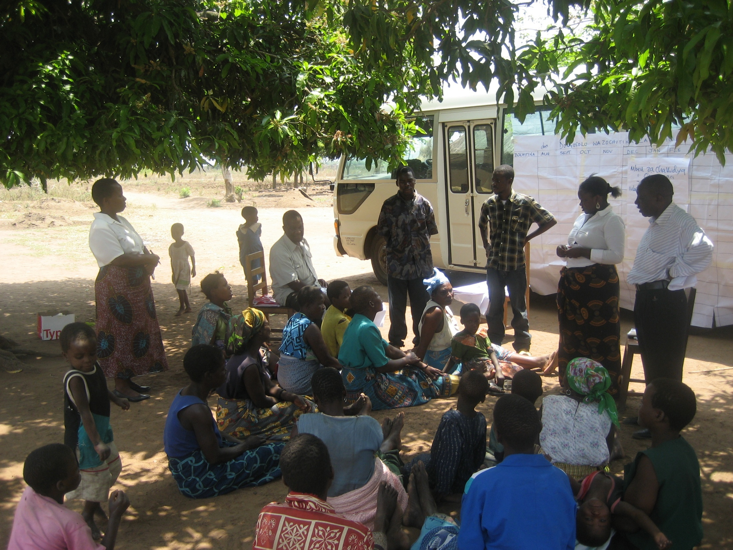
TEAM OF FACILITATORS DISCUSSING ISSUES WITH FARMERS

Slide 19
GENDER AND HIV& AIDS MAINSTREAMING PROCESS
Gender and HIV/ AIDS concerns, issues, needs and priorities
  IDENTIFICATION
  INTERNALIZATION
INTEGRATION
4Is
to
4Ps
policies, project programmes in partnership
INSTITUTIONALIZATION

Slide 20
AIM OF GENDER, HIV AND AIDS MAINSTREAMING
  To reduce the impacts of gender disparities, HIV and AIDS on the projects/programmes mandate and vice versa.

Slide 21
IMPORTANCE OF GENDER, HIV AND AIDS MAINSTREAMING…….
    To reduce or remove gender disparities or imbalances in participation in programs and projects activities
    To reduce or remove gender disparities in access and control of resources and benefits from projects and programs

Slide 22
    To assist programmes or projects not to perpetuate or introduce gender disparities.
    To prevent further infections of HIV for men, women, boys and girls involved in programmes and projects

Slide 23
To minimize the impact of HIV and AIDS on men, women, boys and girls or affected households in programmes and projects.
To ensure proper and focused targeting in programmes and activities according to the existing disparities and impact of HIV and AIDS.

Slide 24
PROCESS FOR MAINSTREAMING GENDER, HIV AND AIDS IN PROGRAMMES AND PROJECTS
The process for mainstreaming Gender, HIV and AIDS in programs and Projects is the same.

Slide 25
IDENTIFY AND PRIORITIZE ISSUES AND CONCERNS
Identification is done with the work place and community’s gender categories and in collaboration with relevant stakeholders.
Gender & HIV/ AIDS responsive participatory tools are used like Havard analytical frame work engendered PRA tools in addition to secondary data from relevant stakeholders (using checklist or questionnaire).

Slide 26
IDENTICATION OF ISSUES AND CONCERNS……..
It is essential that all gender categories and relevant stakeholders express the issues and concerns.
Prioritization is done using a gender responsive procedure. Priorities of each gender category is respected.

Slide 27
IDENTIFICATION OF ISSUES AND CONCERNS…..
Each project and programme should clearly show the gender, HIV and AIDS issues and/ concerns it is addressing.

Slide 28
INTERNALIZATION
To be convinced and committed to deal with the identified Gender, HIV and AIDS issues and concerns.
The objective is to own the issues and concerns hence practical and real life experiences should be used in terms of drama, role-plays, case studies and focus group discussions.

Slide 29
INTEGRATION
This means packaging of interventions to deal with gender , HIV & AIDS issues and concerns in the core business with quality participation of all gender categories.
Development of interventions involves discussing the prioritized issues and concerns with the various targeted gender categories to come up with strategies.

Slide 30
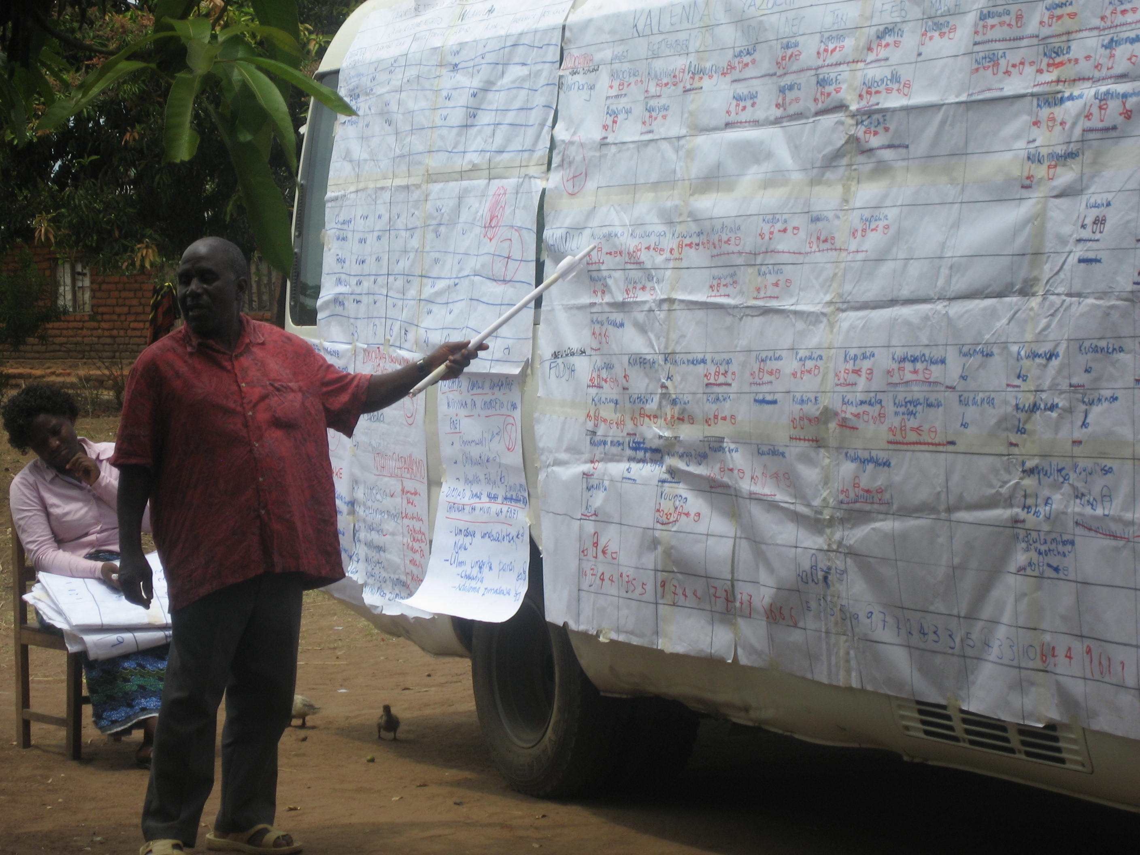
A FARMER PRESEMTING AN ACTION PLAN OF ACTIVITIES

Slide 31
INTEGRATION…….
The strategies and actions are developed into a gender, HIV and AIDS responsive action plan with indicators, targets and required IEC materials.
Where a project or program cannot meet the needs, other potential sources of assistance should be identified.
.

Slide 32
INSTUTIONALIZATION
Means enhancing and scaling up integration of Gender, HIV and AIDS interventions in Agricultural projects and programs by organizing and strengthening support structures.
For example formation of Gender, HIV and AIDS committees, desk officers to support mainstreaming of Gender, HIV and AIDS interventions.

Slide 33
CHARACTERISTICS OF GENDER, HIV AND AIDS RESPONSIVE PROJECT/PROGRAMME
Activities are analyzed from a Gender, HIV and AIDS perspective
Data is Gender Disaggregated
Gender, HIV and AIDS analysis of a project is done on a routine basis and the project is adjusted according to findings
Projects or programmes are continuously monitored for impact on Gender, HIV and AIDS.

Slide 34
CASE STUDY
Mr. Mbewe’s Case Study:
Gender, HIV and AIDS Issues/Concerns and predisposing factors.

Slide 35
Group Discussion Questions
What are the Gender, Issues and concerns you can isolate from the case study.
What are the HIV and AIDS issues you can isolate from the case study?
Isolate predisposing factors/activities to risky behaviour.

Slide 36
CONCLUSIONS
Ignoring mainstreaming of gender, HIV and AIDS in programmes and projects would mean:
Ignoring the people factor in development equation
Underachieving on the expected outcomes
Perpetuating gender inequality &
Bigger contribution to further spread of HIV.

